Slide 1
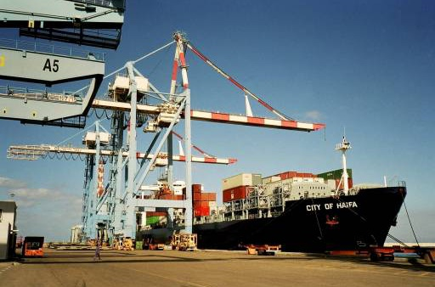
44 Jaffa St. Haifa, 31331
ISRAEL
Tel: 972-4-8509000
Fax: 972-4-8556888
www.tiran.co.il

Slide 2
Core Activity:
Shipping Agency
Forwarding
Customs Clearance
Trading Agriproducts
Trading activity
Logistics Jordan
Aquaculture activity
Projects

Slide 3
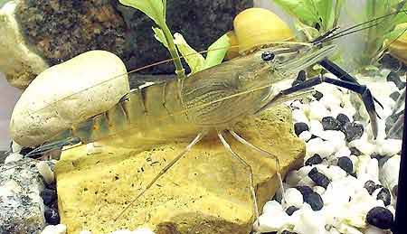
Monosex all-male culture
The androgenic gland sex differentiation insulin biotechnology

Slide 4
Increasing Yields of the Freshwater Prawn
Diagnostic tools and non-invasive intervention in the production of monosex populations
Prof. Amir Sagi

Slide 5
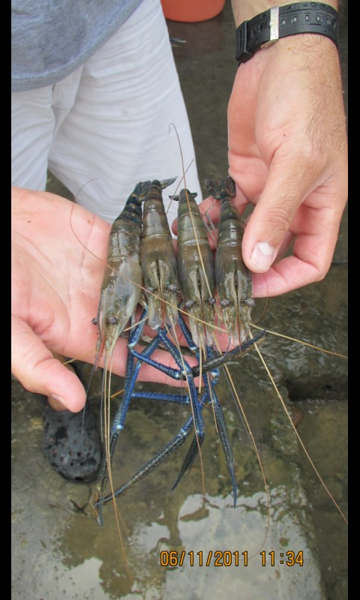
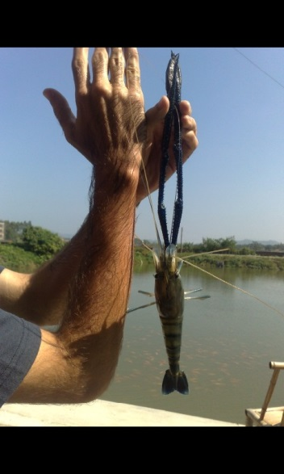
Male Differentiation is Controlled by the Androgenic Gland
The Androgenic gland (AG) mediates sex differentiation and growth rate
Removal of AG results in males (neo-females) that are able to reproduce with normal males

Slide 6
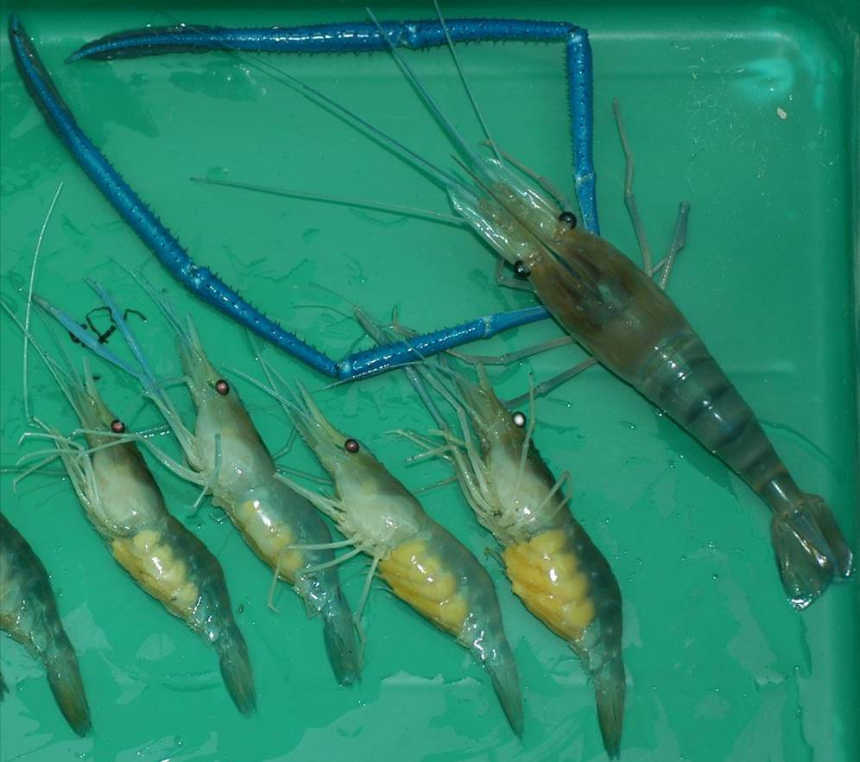
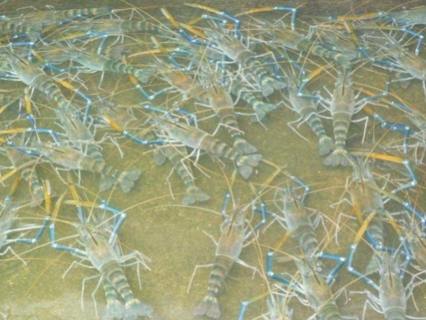
Macrobrachium rosenbergii dimorphic growth in favor of all-male culture and selective harvest
&
~60% higher income
Field study in India
Nair et al., 2006
2cm
* Includes only the marketable yields (≥30g)
Modified from Sagi et al, 1986
Notes:
In the giant freshwater prawn Macrobrachium rosenbergii males grow faster than females and reach higher weights at harvest. In this picture, to the left are four small sized egg berried females along with a markedly larger male from the same population to the right.
M. rosenbergii is an important species in aquaculture with growing demand in developing countries.
Growth experiments of monosex culture in M. rosenbergii were carried out showing that all male culture gained higher yields and reached market size at a faster rate compared with mixed and all female populations pointing on the economical advantages of prawn monosex culture.
At present, monosex culture of M. rosenbergii is commonly achieved trough manual segregation of males from mix populations gaining up to 60% increased income to the growers.
It thus became obvious that an efficient biotechnology for producing prawn monosex populations is required.
6

Slide 7
Development Rational for a Novel Non-invasive Technology for Male Switching
Current micro-surgery technology, active in several sites in the Far East, serves as a proof-of-concept. This invasive technology is limited by:
Skillful labor intensive requirements
Lacks easy to use diagnostic and quality assurance tools
The Novel non-invasive technology will include:
Diagnostic tool for sex identification and quality assurance
Food mediated agent, non-genetically modified organism (GMO), for sex alteration
Based on our scientific knowledge of AG gene function

Slide 8
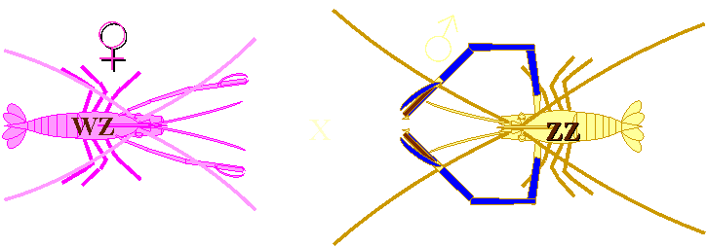
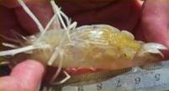
Neo-female and Male Prawns Produce an All-Male Population
Male Prawns are homozygote (ZZ)
Female Prawns are heterozygote (WZ)
Crossing Neo-female (males without AG) and male prawns results in an all male population
♂
X
50%
WZ
50%
ZZ
AG
Neo
ZZ
ZZ
X
100 %
ZZ

Slide 9
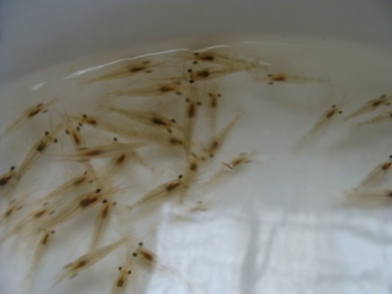
♂
Androgenic gland removal results in sex reversal
X
Phase I
50%
WZ
50%
ZZ
AG-Silencing
Neo
ZZ
ZZ
X
Mass production
of broodstock
100 %
ZZ
All male
AG
Neo
ZZ
Phase II
All Male Population –
over 60% Increase in income

Slide 10
Growth performance of All-male population and Mixed population in earthen pond in Vietnam
Modified from Aflalo et al, 2006

Slide 11
Mr-IAG- BGN patent
RNA silencing of insulin-like gene in prawn and uses thereof. PCT/IL2009/000127 (priority: February 4, 2008)
Worldwide exclusive license:
Tiran Shipping
Contact: HAIM AVIOZ – havioz@tiran.co.il

