Slide 1

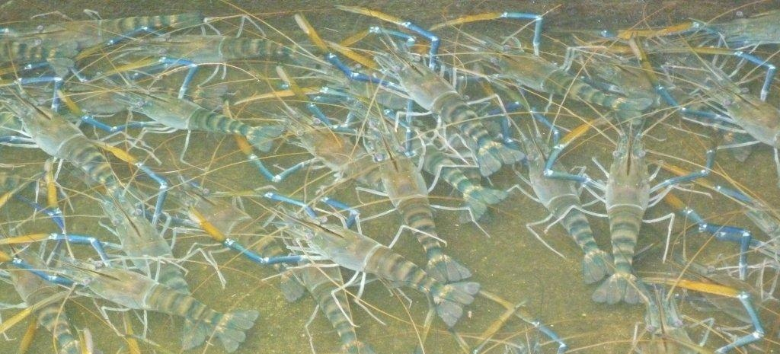
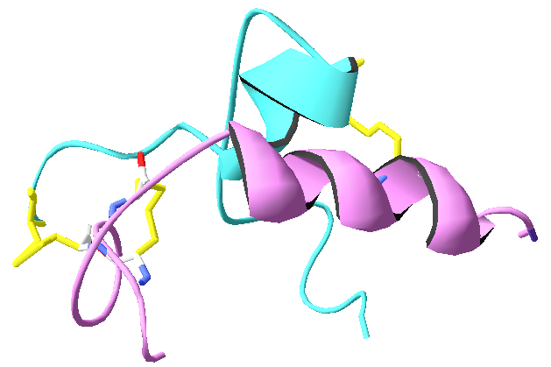
Insulin-like androgenic hormones and monosex culture of prawns:
The first implementation of RNA-interference in aquaculture
Amir Sagi
Ben-Gurion University of the Negev, Israel
Notes:
In this talk I will address the androgenic gland which is the key regulator of sexual differentiation in crustaceans. I will discuss monosex biotechnology that is based upon this unique gland, focusing on the ongoing research and development of molecular tools recently developed by our laboratory. These tools have the potential to revolutionize the entire crustacean aquaculture industry.

Slide 2
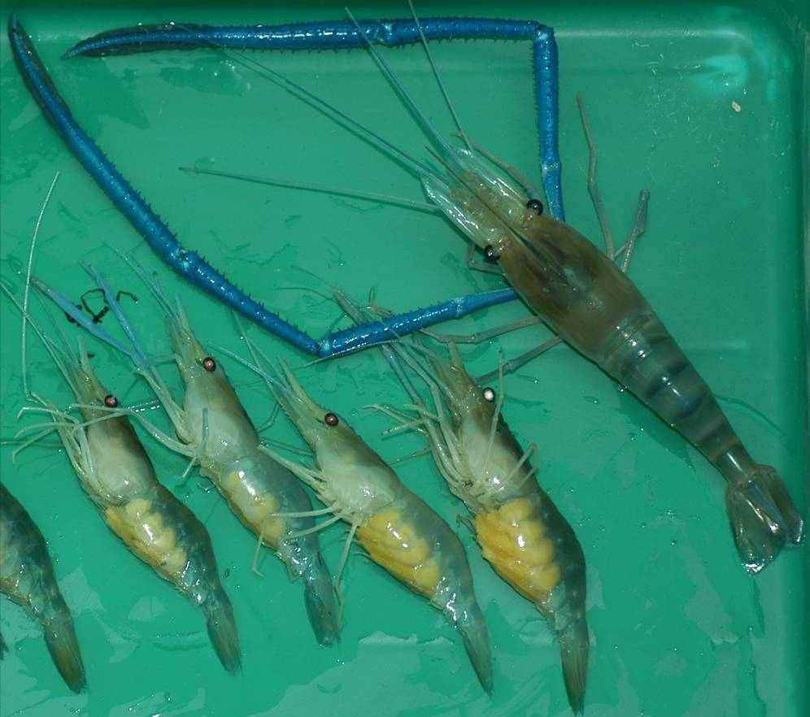
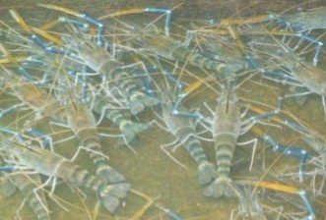
M. rosenbergii dimorphic growth pattern in favor of males
&
~60% higher income
Field study in India
Nair et al., 2006
2cm
* Includes only the marketable yields (≥30g)
Modified from Sagi et al., 1986 Aquacult.
Notes:
Macrobrachium rosenbergii males grow faster than females and reach higher weights at harvest. In this picture, to the left are four small sized egg berried females along with a markedly larger male from the same population to the right.
All-male population culture was shown to gain higher yields and reach market size faster than mixed and all female populations, pointing on the economical advantages of prawn monosex culture.
Moreover, in a field study recently conducted in India, the grower’s income was calculated to rise by 60% when discarding the less-profitable females of the species.
2

Slide 3
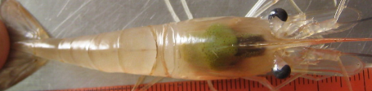
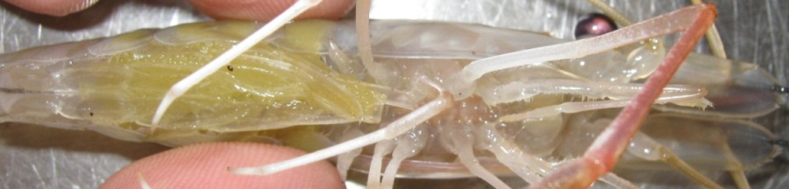
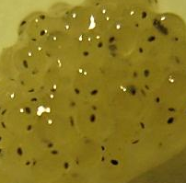
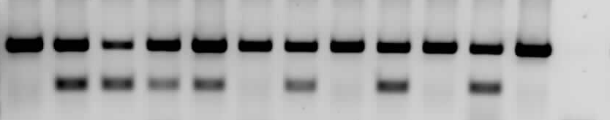
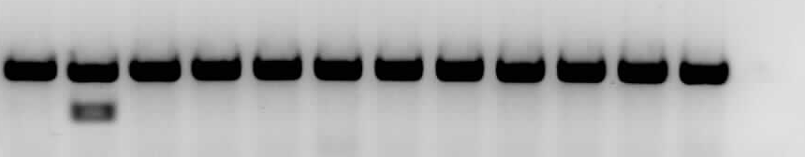
Mr-IAG silencing induces full functional sex reversal
1 cm
3 mm
Female specific sex marker
Control
female
Neo female
♂
♀
F1 (control female progeny)
n.c.
♂
♀
F1 (neo-female progeny)
n.c.
P.C.
F.S.
Ventura et al., Heredity, 2011
Notes:
Repetitive injections of dsMr-IAG have finally enabled us to alter the sex of genetic males into functional 'neo-females'. At the top panel, we can see a dorsal view of a genetic male, with a fully developed ovary indicated by an arrow. At the bottom panel, we can see the same neo-female carrying eggs, after a successful mating with a normal male. Some of the eggs are magnified, showing normal embryos development.
Sex reversal was validated using genomic sex markers. While the positive control is amplified in all the samples, the sex marker is amplified only in the females. To the left is a normal female with a mixed progeny. To the right is the neo-female with its progeny that are all genetically males, along with normal male and female as controls.

Slide 4
IAG silencing and prawn monosex biotechnologial cascade
WZ
X
ZZ
50%
WZ
50%
ZZ
RNAi IAG
Neo
ZZ
ZZ
X
100%
ZZ
Modified from Aflalo et al., 2006 Aquacult
Notes:
Going back to our scheme, but this time instead of AG ablation, a temporal dsRNA silencing is applied, resulting in a full and functional sex reversal from male into a neo-female.

Slide 5
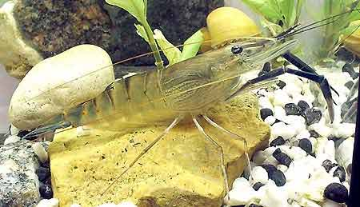


Monosex all-male culture
The androgenic gland
Sex differentiation
Insulin-like
Biotechnology
Patent: RNA silencing of insulin-like gene in prawn and uses thereof. PCT/IL2009/000127 (priority: February 4, 2008) WO2009/098683, US2012/073508.
Notes:
For the first time in crustaceans commercial production, a non-inherited, temporal gene silencing biotechnology is available.
This technology was developed at the National Institute of Biotechnology at Ben-Gurion University of the Negev (BGU).
It is based on an insulin-like androgenic gland hormone from M. rosenbergii (termed Mr-IAG and fully patented) and on the use of specific sex markers..
The technology does not use exogenous hormones or chemicals and it is not producing genetically modified prawns (completely non-GMO technology). As the intervention is temporal, it is not transmissible to next generations.

Slide 6

How is RNAi working
(non GMO)
Mr-IAG
Insulin-like
androgenic hormone
RNA
5’-
-3’
A
U
C
U
U
G
C
A
U
C
C
U
G
C
A
U
A
A
U
G
C
A
U
A
U
C
A
C
A
U
G
A
A
A
A
A
A
A
A
A
A
A
A
A
Temporal dsRNA effect
U
U
G
C
A
U
C
C
U
G
C
A
U
A
A
U
G
C
A
U
A
U
C
A
C
A
U
G
U
A
U
A
A
C
C
U
A
C
G
A
C
G
U
A
U
U
A
C
G
U
A
U
A
G
U
G
U
A
3’-
C
A
A
C
C
U
A
C
G
A
C
G
U
A
U
U
A
C
G
U
A
U
A
G
U
G
U
A
C
-5’
DNA
5’-
-3’
A
T
G
C
A
T
G
C
T
G
C
A
T
A
A
T
G
A
T
A
T
G
C
A
T
C
C
T
G
C
A
T
A
A gene encoding the
Insulin like androgenic hormone
3’-
T
A
C
G
T
A
C
G
A
C
G
T
A
T
T
A
C
T
A
T
A
C
G
T
A
C
G
A
C
G
T
A
T
-5’
Notes:
In a more simplified way,
In the cell, DNA will transcribe into mRNA which will then is translated to protein.
When introducing dsRNA homologous to our target mRNA, the endogenous Dicer –RISC machinery will be activated, reducing the mRNA template and hence temporarily eliminating the translation of our target protein.

Slide 7
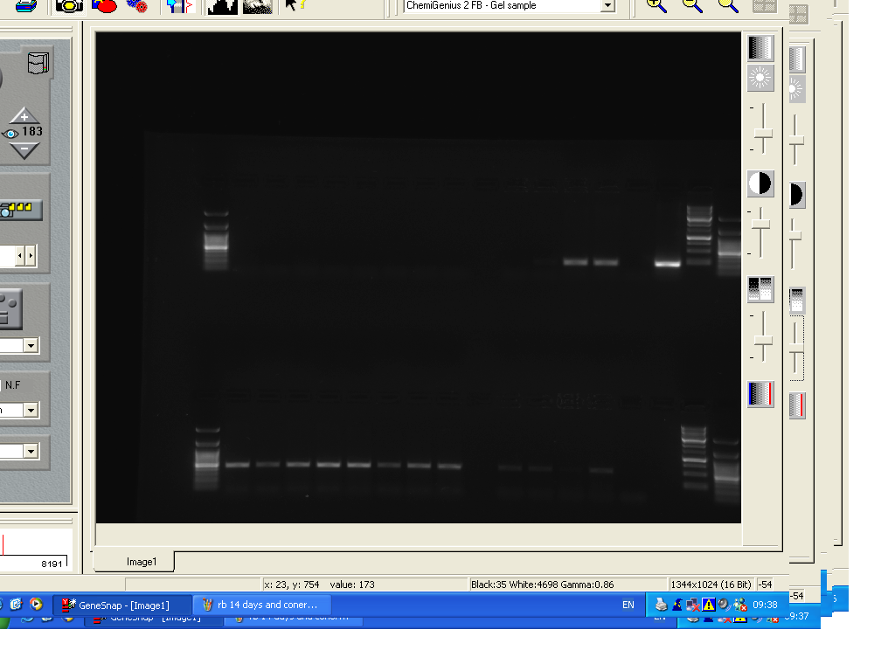
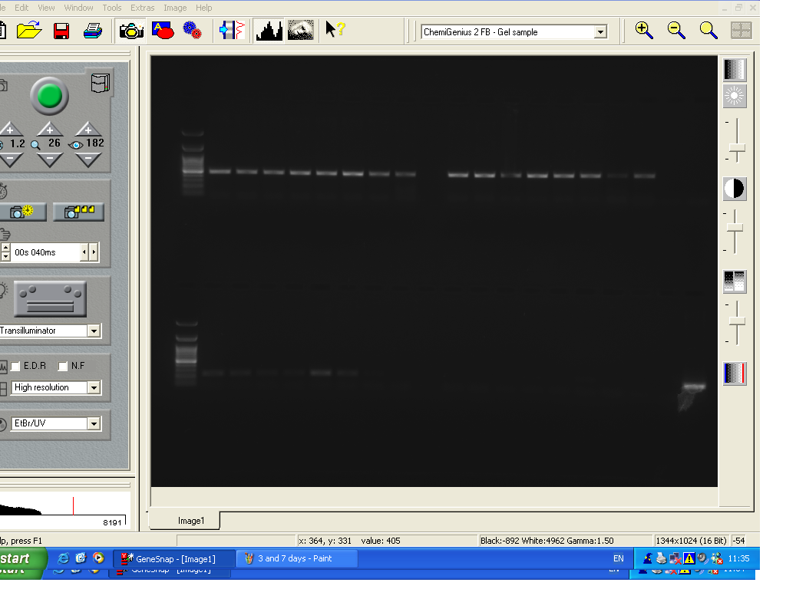
Clearance of exogenous dsRNA in injected prawns
3
7
14
Time (Days)
Controls
3 days
7 days
14 days
PC
NC
T₀
T₀
T₁
T₁
1
2
3
4
5
6
7
8
9
10
11
12
13
14
15
16
17
18
19
20
21
22
23
24
Notes:
Clearance of exogenous non specific dsRNA was tested 3, 7 and 14 days after dsRNA administration.
As shown by RT-PCR dsRB could be detected in some of the males 3 days after the dsRB injection and could not be detected 7 and 14 days after the dsRB injection. M. rosenbergii -actin (bottom) was used as a positive control for the cDNA preparation.
RT-PCR using DDW or cDNA of dsRB as templates served as negative and positive controls.

Slide 8
RNAi temporarily reduces
Mr-IAG expression
Real time RT-PCR
Notes:
When we are tracing Mr-IAG expression levels after dsMr-IAG administration, the temporal effect of dsRNA administration is demonstrated. 3 days post dsRNA administration only basal expression levels of Mr IAG were detected, increasing almost up to full recovery after 28 days.

Slide 9
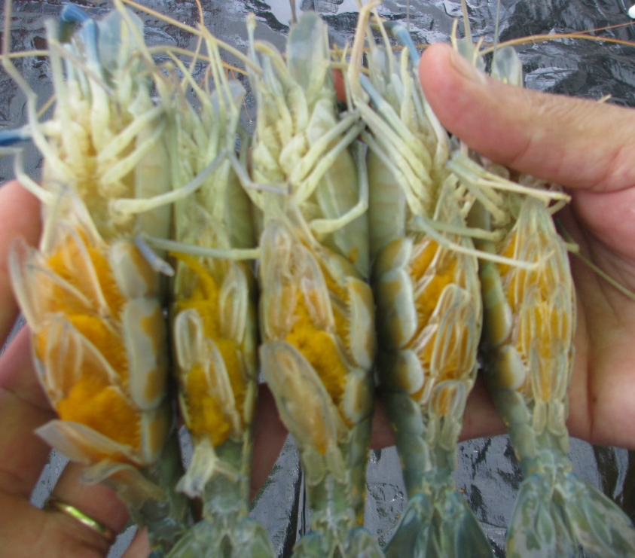
Neo females (sex reversed males) reproductive performance
 | Females | Neo females
Body weight (g) | 32.03 ± 0.28 | 41.31 ± 0.22
BSI (%) | 13.3 ± 1.63 | 12.7 ± 1.28
Eggs/g BW | 859 ± 120 | 845 ± 67
Notes:
When comparing the reproductive performance of neo females to that of normal females no significant difference was observed in term of brood size and the number of eggs per gram body weight. No significant differences were observed also in the duration of the larvication or in the survival rates of the larvae.

Slide 10
Selective breeding scheme combined with all-male selective production
BGU line
Local strain
1st Generation
BGU line
Neo
female
Selected
Local strain
All-male PLs
to growers
G₁
G₁
2nd Generation
BGU line
Neo
female
Selected
Local strain
All-male PLs
to growers
G₂
G₂
Modified from Aflalo et al., 2012
Notes:
In addition, as we aware of genetic inbreeding, Our biotechnology could also be combined with selective breeding scheme in which only crossbred offspring of a neo-female of one best selected breed and a male from the other best selected breed will be released to commercial farms keeping clean lines of fresh water prawns. This will be done in each generation of the selective breeding program.

Slide 11
Recommendations
Protect from decay by crossing BGU with Local lines (do not reuse crosses, no backflow of genes).
Insert a selectively bred line into the portfolio (improved lines in Vietnam, India, or other sources).
Pathogen free declaration of the BGU line.

Slide 12

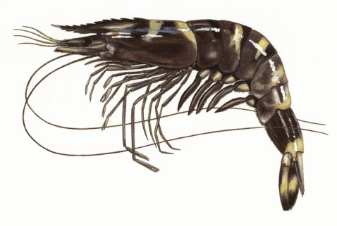
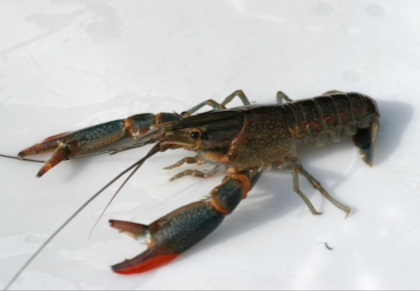
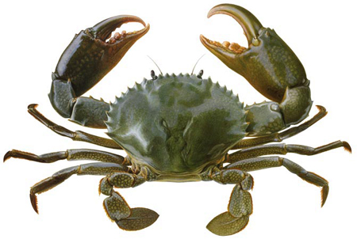
Up to this point, the technology
Temporal RNAi
No hormone treatment
No chemicals
Non GMO
Aquaculture production enhancement
Price
Delivery
17.8 B $
Environmental
Solutions
Bio-control
5.4 B $
Notes:
We have seen thus far one example for IAG manipulation which leads to a commercially important sex reversal. This example could be broadened and tailored to fit all aquaculture- important crustacean models and perhaps even serve as a part of a broader solution for coping with invasive crustacean species.

Slide 13


Thank you
Dr. Tomer Ventura Ohad Rosen
Dr. Simy Weill Dr. Ziv Roth
Dr. Eli D. Aflalo Yaara Lazar
Dr. Rivka Manor Omri Sharabi
Dr. Lilah Glazer
Funding sources: BARD TIRAN Shipping Ltd.

